Slide 1
BRITISH AIRWAYS – REVIEW ANALYSIS
Reviews powered by Skytrax

Slide 2
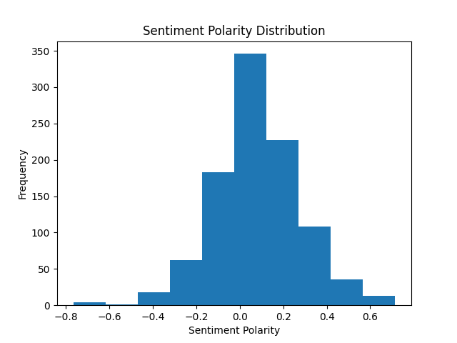
Insights
Mostly neutral responses.
Let’s split reviews into ‘Terrible’, ‘Bad’, ‘Neutral’, ‘Good’, and ‘Great’
‘Neutral’ is most frequent with roughly 350 reviews out of 1000 (35%)
In general, more positive reviews.
Almost no ‘Terrible’ reviews, compared to about 50 ‘Good’ and ‘Great’ reviews

Slide 3
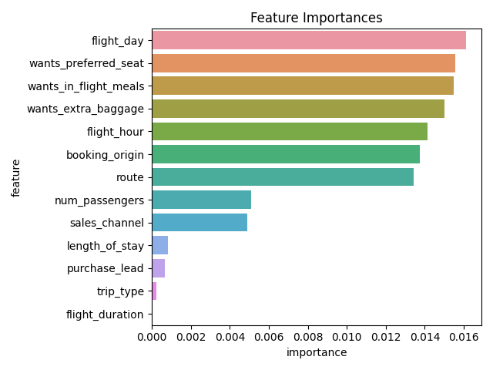
Insights
Most important factor: flight day
Least important factor: duration
Great importance:
Flight day & hour
Preferred seat, meals & extra baggage
Booking origin
Route
Medium importance:
Number of passengers
Sales channel (Internet…)
Small importance:
Length of stay at destination
Trip type (round, one-way, circle)
Purchase lead

